Slide 1

For loop
Lecturer
Rokas Slaboševičius
Data

Slide 2
Today you will learn
For loop
For loop
01

Slide 3
For loop
For loop
We have already learnt the while loop, now let's look at the for loop, the condition of the while loop is described by a single conditional statement, the description of the for loop has 3 sections:
The first section describes the start of the iteration.
The second section describes the condition up to which the iteration will take place.
The third section describes the size of the "steps" that will be taken from start to finish.

Slide 4
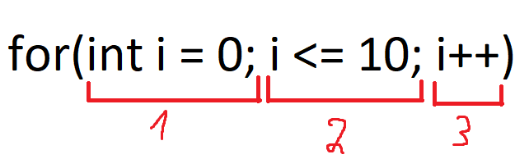
For loop
For loop
In the first section, we say that the loop will start at the value 0 of variable i (we declare variable i and initialize it immediately in the first section).
In the second section, we say that the cycle will run until i is less than or equal to 10
In the third section, we say that after each iteration, the value of i will increase by 1.

Slide 5

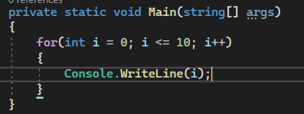
For loop
For loop
This is what the code would look like with the output

Slide 6
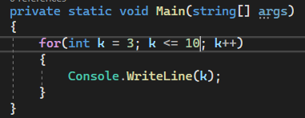

For loop
For loop
It should also be noted that the variable does not have to be called i, this is more of a collective habit of programmers. The most commonly used letters are i,j,k.
Another observation is that the start of the loop does not have to be 0, the start of the loop has to match the requirements of your logic, in this example the loop will start at 3 and iterate to 10.
Later we will learn that iteration is not limited to numbers, so
understand the principle of describing the start and end of a cycle.

Slide 7


For loop
For loop
Another observation is that the variable to be iterated in the third section can be incremented not only one by one, but also by all mathematical operations.
It is worth noting that we iterated to 10 but it printed to 9, why is that?
A more complex description of the third section condition may make it more difficult to manage the cycle.

Slide 8
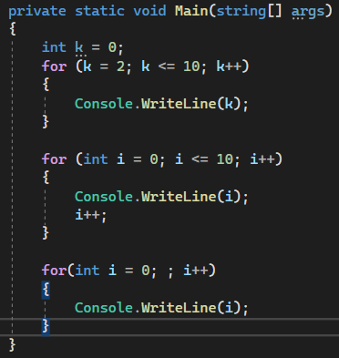
Bad practices
For loop
Creating a variable separately from the loop.
Changing the iterated variable during a cycle.
No loop termination condition (infinite loop)

Slide 9

For loop
Task 1
Write a loop that will print all even numbers up to 100 (without using conditional statements like if)
Write a loop that counts the sum of the numbers from 1 to n (n is the number entered by the user).
Write a program that prints n squares of integers, where n is user input.
Write a program that calculates the arithmetic mean of all the numbers from 1 to n(n is a number entered by the user).
Write a program that prints a "column" of "*" characters, the height of which is an input from the user.
Write a program that prints all numbers that are divisible by 3 without remainder, from 1 to 100(without using conditional statements like if).

